Slide 1
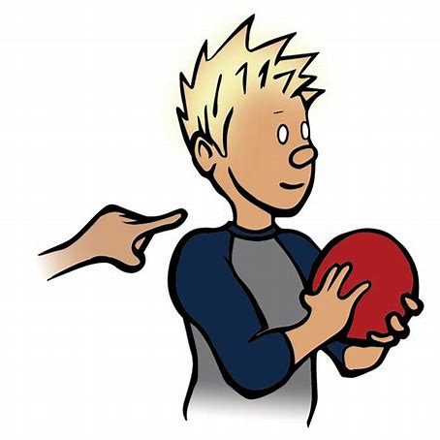

Daily Review
Reminder
Stimulus → Receptor → Control centre → Effector → Response
Stimulus-Response Model
Stimulus → Receptor → Control centre → Effector → Response
Stimuli in the environment are detected by receptors in our sense organs.
Sensory neurons pass nerve impulses to the CNS where interneurons process the information.
Nerve impulses are sent to the muscles/organs via motor neurons in the PNS.
Muscles / organs then work to create a response from the body.
Describe the stimulus response model for when someone taps you on the shoulder.
Describe the stimulus response model for when you step on a sharp object on the beach.
What is the difference between these two stimulus response models?

Slide 2
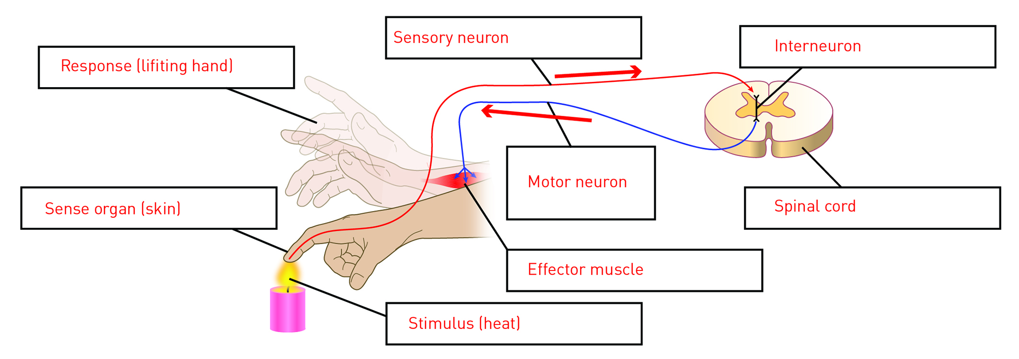
A reflex action is an involuntary, almost instantaneous movement in response to a stimulus.
During a reflex action, the sensory neuron carries the message from the receptor to the spinal cord as usual.
Match the following keywords with their correct place in the stimulus response model diagram.
Response
Sense Organ
Sensory Neuron
Effector
Spinal Cord
Interneuron
Stimulus
Motor Neuron
3
4
8
6
2
5
7
1

Slide 3
Neurons carry electrical messages, called nerve impulses, from one part of the body to another at very high speed.
Match the following sentences.
A Sensory Neurons | 1 carry information from the CNS to the PNS | 4 have no myelin sheath
B Interneurons | 2 carry information from the PNS to the CNS | 5 have cell body in the dendrites
C Motor neurons | 3 carry information from neuron to neuron | 6 have cell body on the axon periphery
What is a synapse?

